Slide 1
Project 4 - Heart Disease
File created on: 6/11/2023 9:33:48 PM

Slide 2
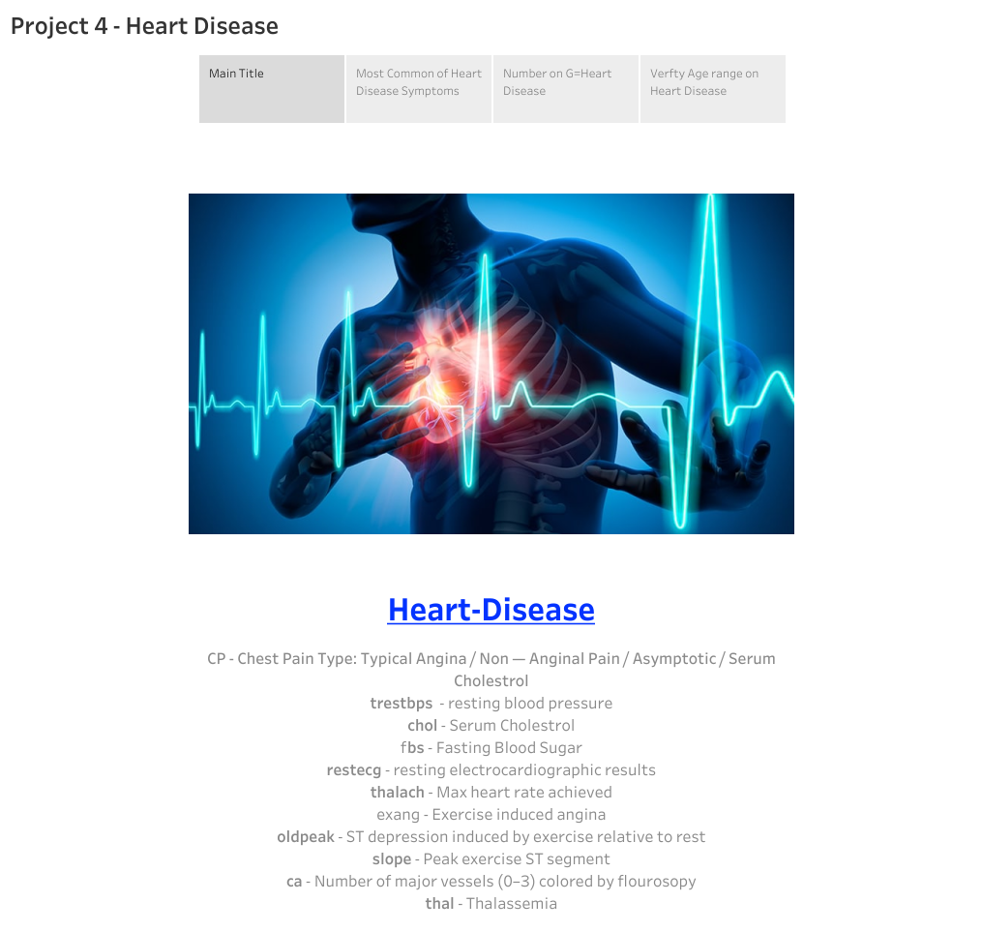

Slide 3
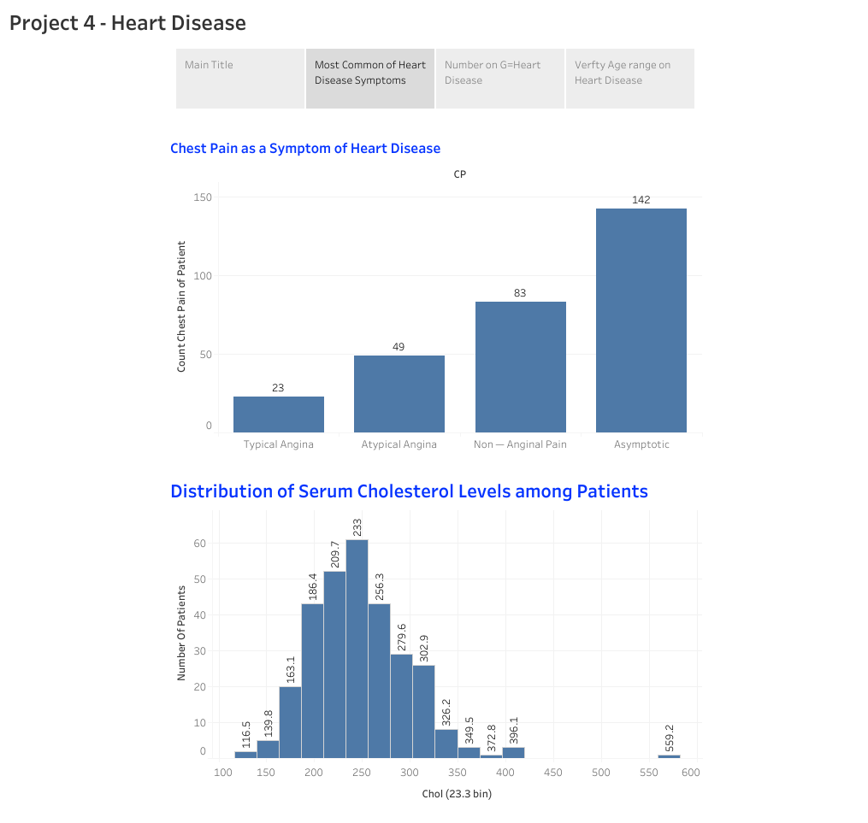

Slide 4
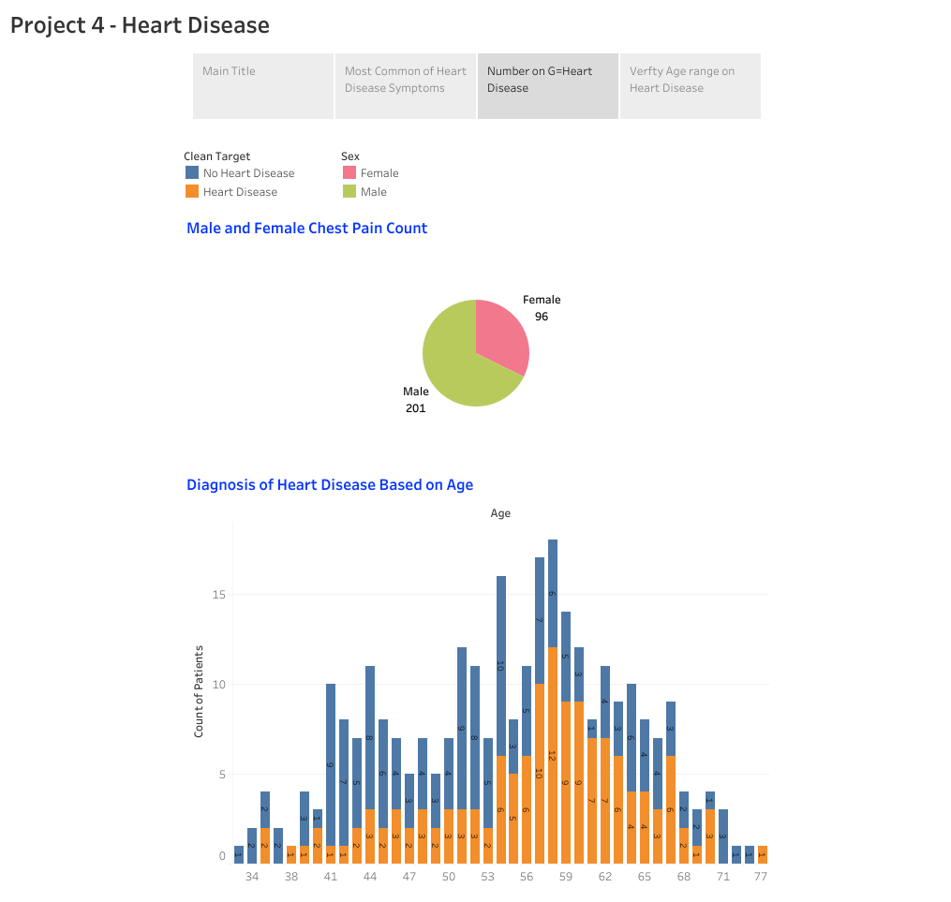

Slide 5
